Slide 1












Summer practice 2023
GAME
2048
By
Mădălina-Maria Mihălucă
&
Constantin Cojbirna

Slide 2




OVERVIEW
GAME STORY
WHAT IS 2048 GAME?
GAME RULES
RULES OF USE
ABOUT SCORE
HOW DO YOU WIN/LOSE?
ABOUT IMPLEMENTATION
CODE EXAMPLES
TIPS & TRICKS
CONCLUSIONS
BIBLIOGRAPHY

Slide 3





GAME STORY
ONCE UPON A TIME, THERE WAS A GIRL WHO LIKED MATHEMATICS VERY MUCH. HER PARENTS BOUGHT HER SOME TEMPLATES WITH NUMBERS, THE GIRL DISCOVERED THE MAGIC OF MULTIPLICATION BY 2, SO, GROWING UP, SHE WANTED VERY MUCH TO IMPLEMENT A GAME.
...AND THAT'S IT!

Slide 4






IMPLEMENTED
IN
VBA
WHAT IS 2048 GAME?

Slide 5









GAME RULES
For this use the up, down, left, right buttons located on the game interface
Use your intelligence to form a strong strategy to reach the number 2048
Join two pieces with the same number so that they add up
2048
Enjoy!

Slide 6





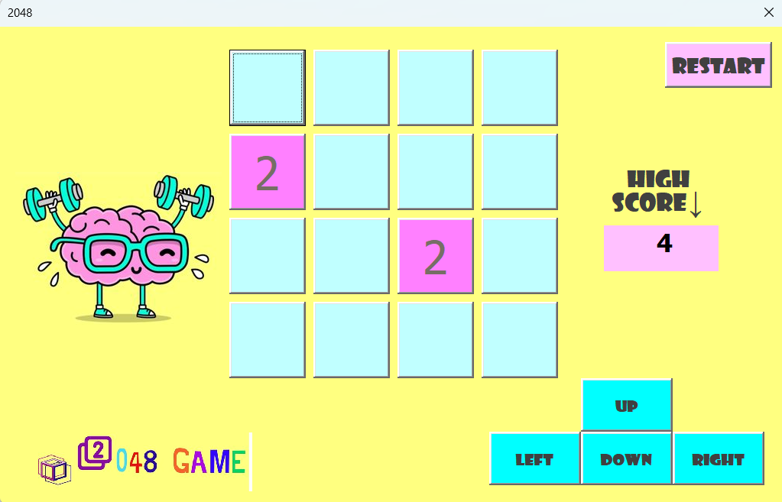


RULES OF USE
CHECK THE GREEN BUTTON
FROM EXCEL
PRESS RESTART BUTTON
FOR RETRY GAME
PRESS ANY BUTTON

Slide 7


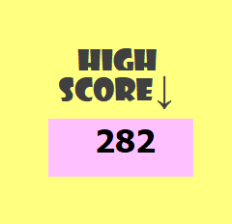


ABOUT SCORE
The score is actually the sum of the pieces on the game board.
Important to mention is that the logic behind the game adds either a piece of 2 or a piece of 4 randomly after the score reaches 100 points.

Slide 8


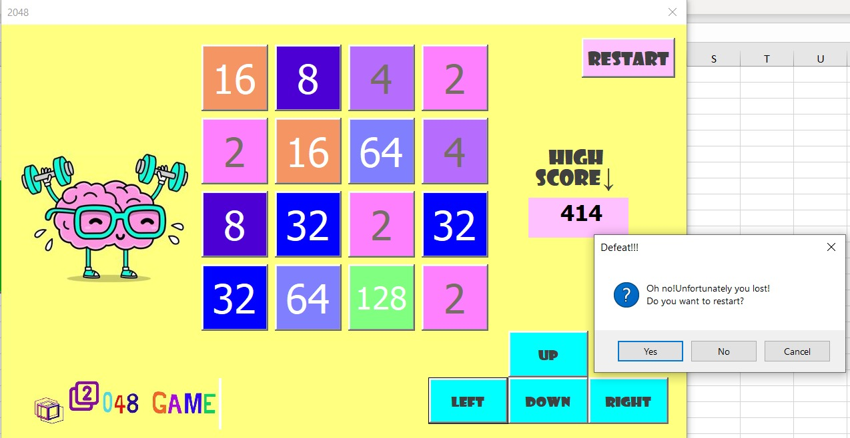

HOW DO YOU ...?
LOSE

Slide 9
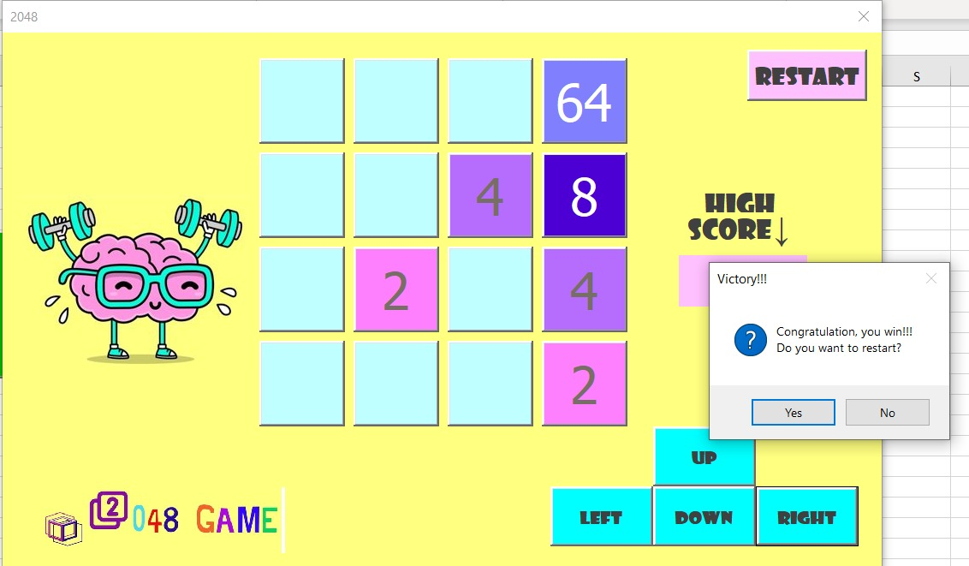

HOW DO YOU ...?
WIN
2048

Slide 10






ABOUT IMPLEMENTATION
----------
----------
VBA

Slide 11

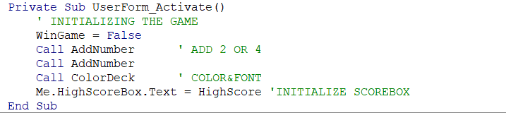

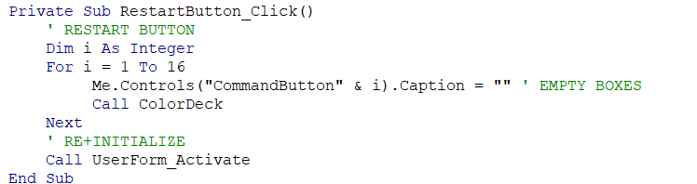

USERFORM_ACTIVATE & RESTARTBUTTON

Slide 12


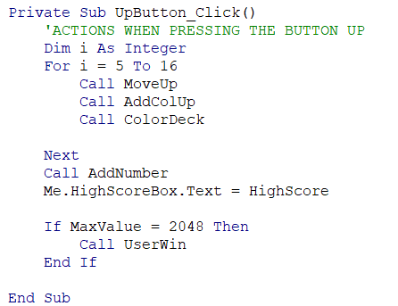


UP_BUTTON
1 2 3 4
5 6 7 8
9 10 11 12
13 14 15 16

Slide 13

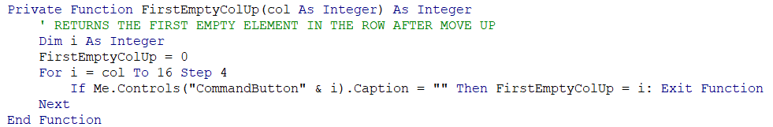

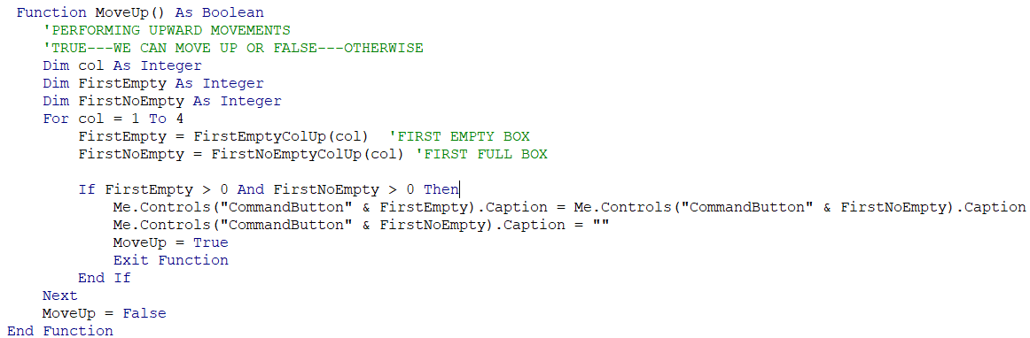
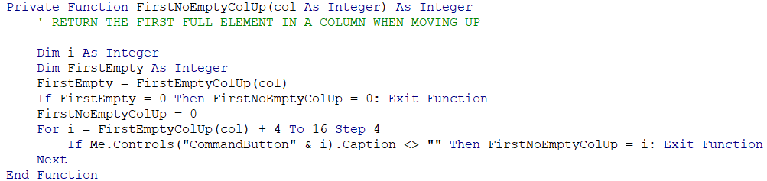
MoveUp, FirstEmptyColUp, FirstNoEmptyColUp
Same code for Down, Left, Right

Slide 14
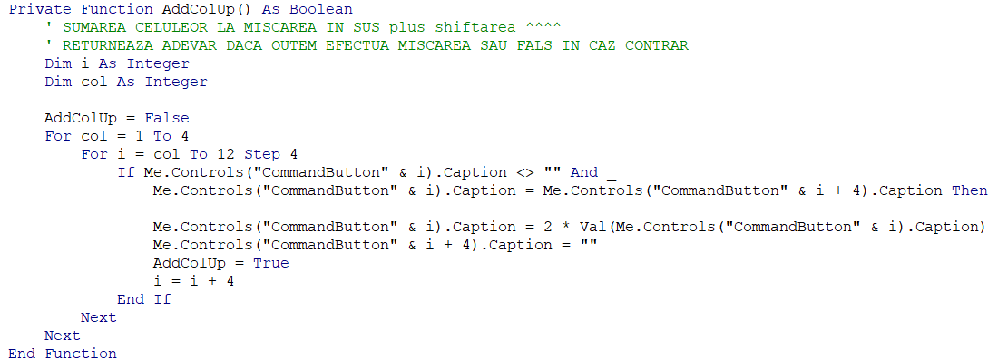

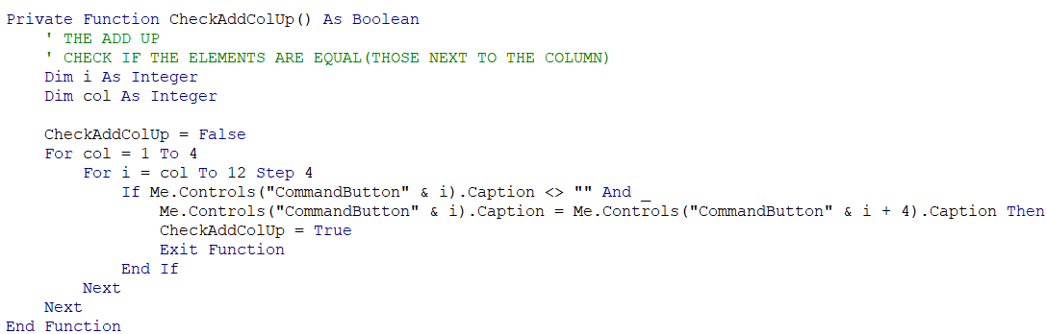

AddColUp & CheckAddColUp

Slide 15

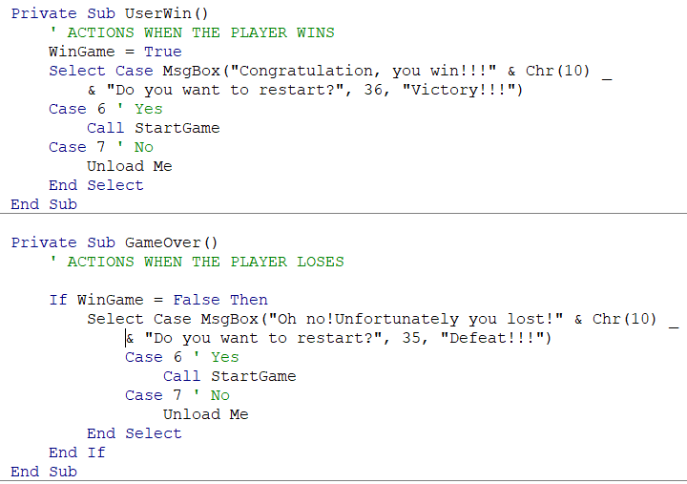


UserWin & GameOver
2048 EXPERT

Slide 16


Tips & tricks
1
2
3
WORK YOUR WAY TOWARDS THE CORNERS
SLOW DOWN AND PLAN AHEAD
DON'T CHASE
LARGE TILES

Slide 17





CONCLUSIONS
We learned to work in a team
We improved our creativity
We learned to program in a new language
We learned that every problem has a solution

Slide 18



BIBLIOGRAPHY
LESSON WITH IGOR PLATON
https://www.automateexcel.com/excel-formatting/color-reference-for-color-index/
https://2048game.com/tips-and-tricks/
https://www.canva.com/design/DAFp3AQQ5P0/oDzoFZ3NjLw57rl87a7gew/edit

Slide 19

THANK YOU

